Slide 1
Multilingual Polarization Detection
Foundations of AI Programming using Python
Submitted by: Kartik Goel:- A25ariu0019
Keshav Garg:- a25ariu0021

Slide 2
Problem statement
Detect polarization in online text
Identify divisive vs neutral content
Handel multilingual data

Slide 3
Objective
Build a machine learning model
Classify text as:
Polarized
Non-Polarized
Deploy model as flask

Slide 4
dataset
Multilingual dataset (eng, hin, etc.)
Format: CSV files
Key columns:
text
polarization

Slide 5
Data preprocessing
Combined multiple CSV files
Extracted text and labels
Cleaned and prepared data

Slide 6
Feature engineering
Used TF-IDF Vectorization
Converted text into numerical from
Selected important words

Slide 7
Model used
Logistic Regression
Binary Classification
Efficient and fast

Slide 8
workflow
Data → Preprocessing → TF-IDF → Model Training → Prediction → Deployment

Slide 9
output
Generated submission.csv
Example:
Polarized
non-polarized

Slide 10
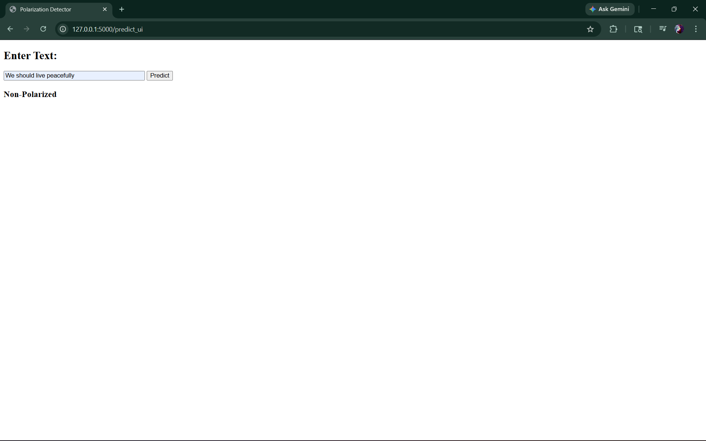
deployment
Built using Flask
Web interface for user input
Real-time prediction

Slide 11
Challenges faced
Understanding dataset structure
Handling multilingual data
Label interpretation issues

Slide 12
results
Models predicts effectively
Works on real-time input
Simple and effective

Slide 13
Future scope
Use deep learning (BERT)
Improve accuracy
Deploy online

Slide 14
conclusion
Successfully bulit ML pipeline
Deployed using Flask
Supports multilingual text

Slide 15
Github
https://github.com/goelkartik66-boop/Milestone_2

